Slide 1
Global Data Protection and Privacy
(Domain Name Industry Impact)
Vlad Dinculescu

Slide 2
What is Data Protection and Privacy
Local laws governing :
What data can and what data must be collected (collection)
How to store personal information (storage and duration)
How to process personal data
How to transfer personal data
How to secure personal data
How to dispose of personal data
Anonymity

Slide 3
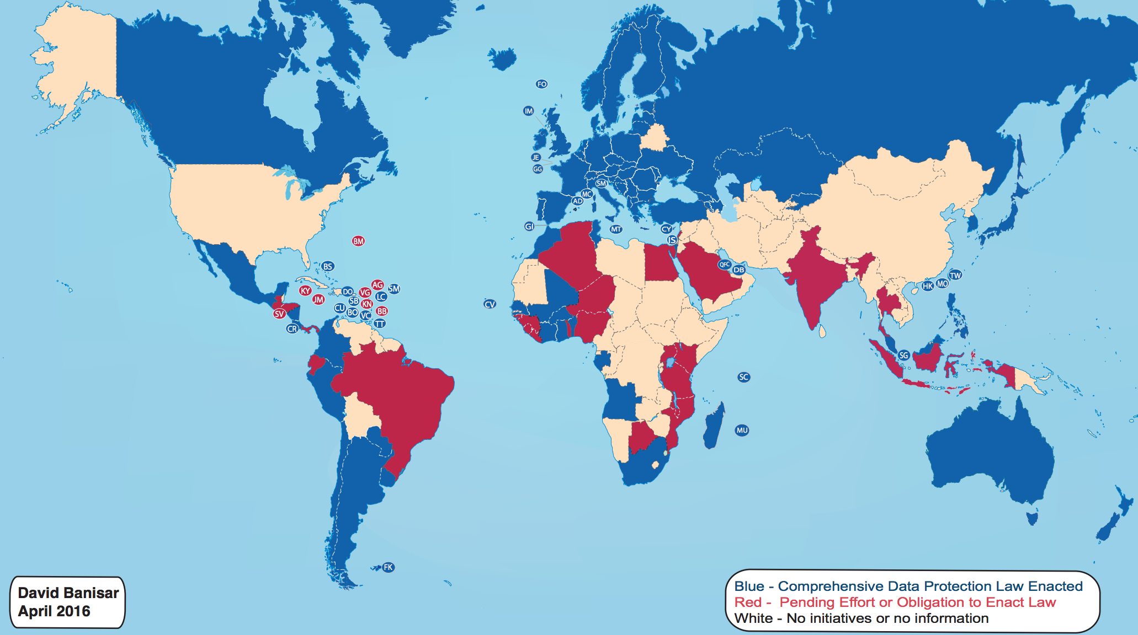
Overview – Global Existing Legislation

Slide 4
Overview (Continued)
Approximately 50% of the world has stringent data protection laws
Developing and second-world countries are catching up with their local versions of laws
Third-world countries (Africa specifically) have yet to develop and implement governance and legislation
The USA has limited/no data privacy in the domain name industry

Slide 5
Rising Issues on the Global Internet
Global internet requires compliance with laws
“What, how, why, where” of data
Laws vary by jurisdiction
Difficult to read and implement all variations
Path of least resistance?
“Keeping Up With the Kar Privacy Laws”

Slide 6
Impact on Domain Name Industry
Registries adhere by local privacy laws (PoPI Act, ECT Act)
Registrars adhere to both local and international laws
ALL registrants have INHERENT rights based in their jurisdiction
Enforcement is required locally as well as globally
Compliance to current and future regulations
Privacy/Proxy Services

Slide 7
Enforcement of Laws
Who is responsible for enforcement
Who defines responsibility and depth?
What are the methods for enforcement
How “private” is private data in a global internet?

Slide 8
Trends in Global Privacy Policy
More countries are adopting laws
Existing laws are amended
Increasingly stringent law enforcement
Global meaning of data protection on the internet
Internet community looking to govern itself

Slide 9
ICANN and Data Protection
ICANN legally contracts both registries and registrars (enforces data collection obligations)
WHOIS vs “WHAT-IS”
No imposition by ICANN for registrars to break local requirements (difficult to implement on global operations)
Privacy/Proxy provision allowance
No clear-cut requirements lead to misinterpretation and non-compliance
ICANN/Internet Community RDS Policy Development Process

Slide 10
Future of Data Protection in Domain Names
Increasing global legislation
Variations and nuances in policies
Is “Most stringent” the right path for global implementation?
Mass confusion leading to failures to comply
Registry Data Access Protocol

Slide 11
Get in Touch
Vlad Dinculescu
+27 (11)5682800
info@dns.net.za
Facebook: Domain Name Services

