Slide 1

Constructive Engagement:
The holy grail to business & brands
Thoughts? Twitter: @EricEdelstein @evly

Slide 2



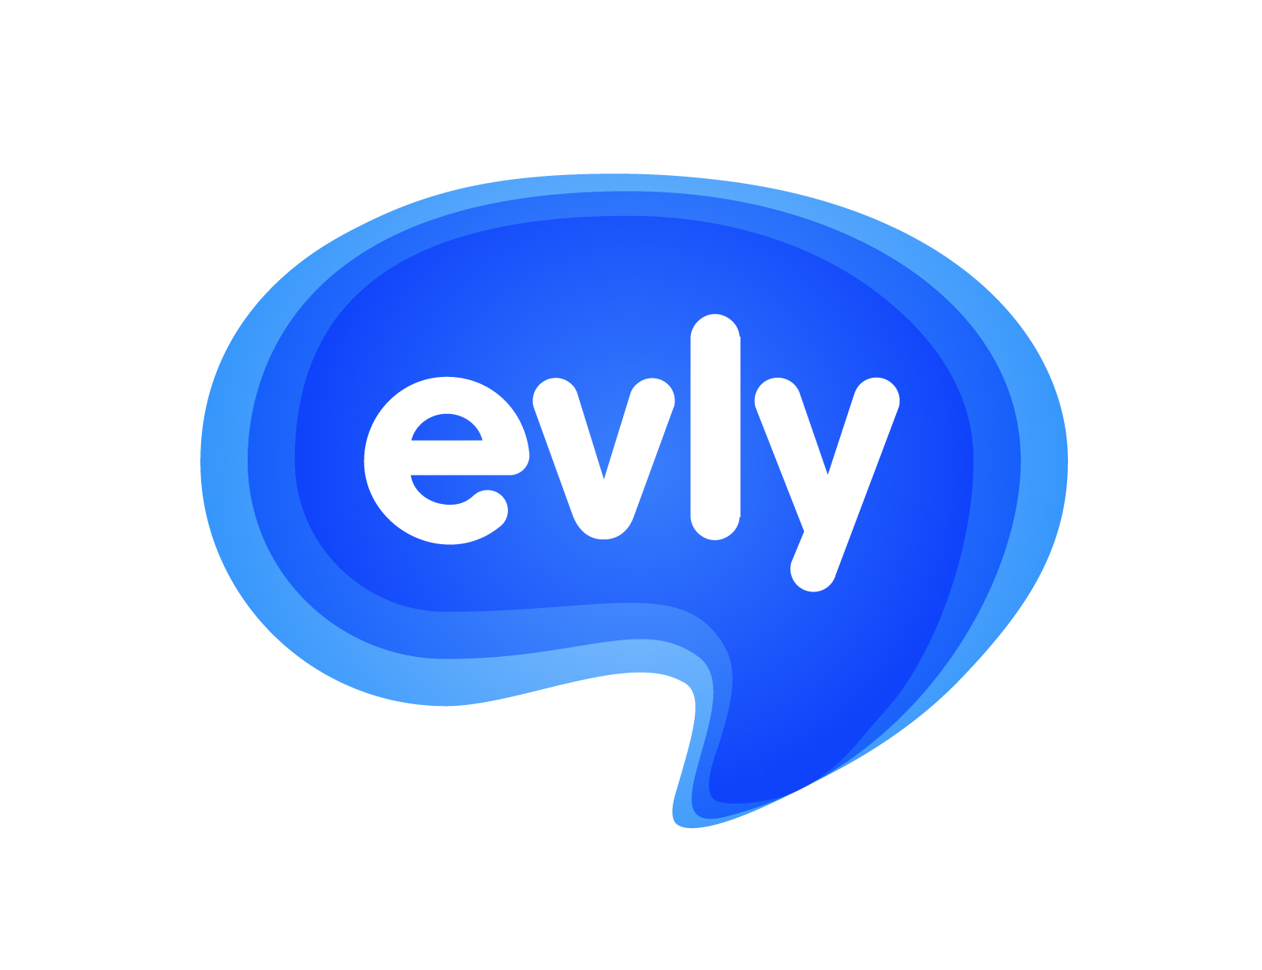

I’ve been in the digital space since 1998…
- SA’s 1st Search Engine Agency
- SA’s 1st Lead Generation Platform
- SA’s 1st Social Media Crowdsourcing Platform
- Social Media Marketing Suite
Any thoughts? Tweet them @evly

Slide 3
Are you a Social Media Expert?
“
We recognize that all who claim to be expert in this arena, who claim to know exactly what to do and how to ideally capitalize, are kidding themselves, or their clients or both.
”
- Fast Company September 2012

Slide 4
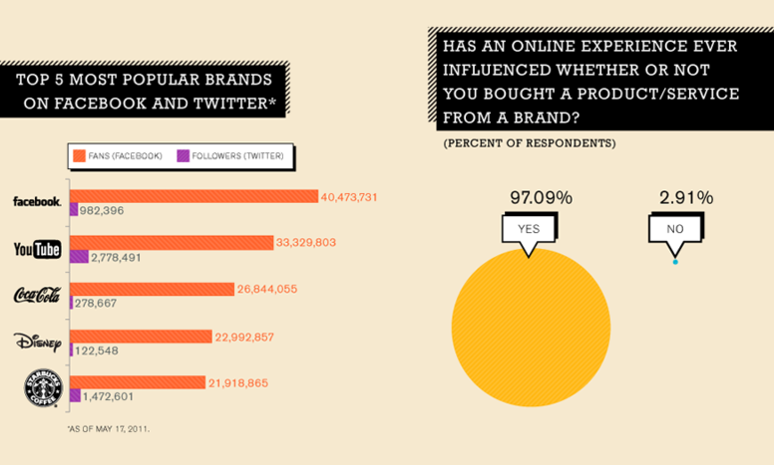

Any thoughts? Tweet them @evly

Slide 5
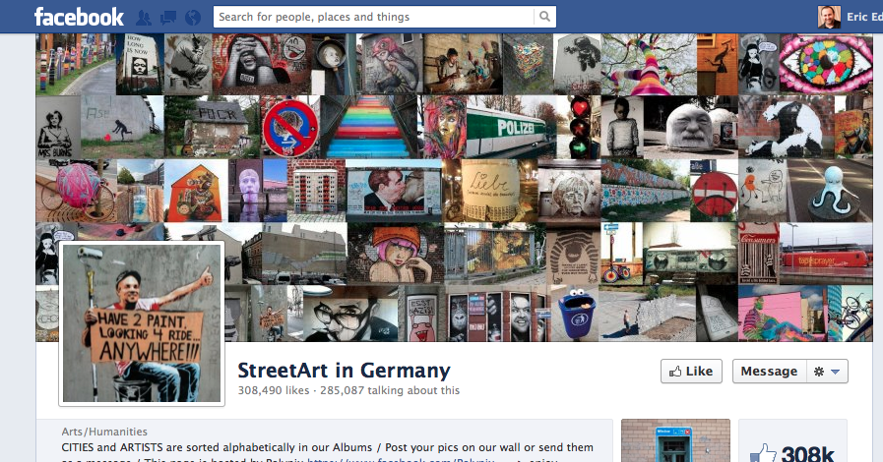
StreetArt in Germany
Any thoughts? Tweet them @evly

Slide 6
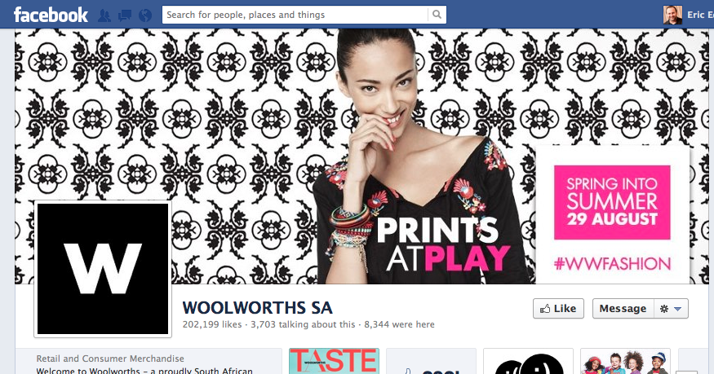
Woolworths SA
Any thoughts? Tweet them @evly

Slide 7

Idols
Any thoughts? Tweet them @evly

Slide 8
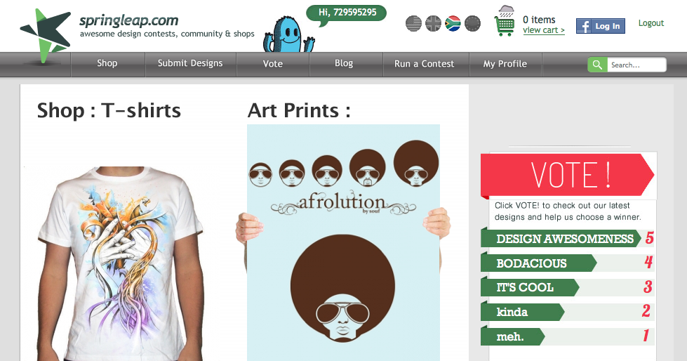
Springleap.com
Any thoughts? Tweet them @evly

Slide 9

99 designs
Any thoughts? Tweet them @evly

Slide 10
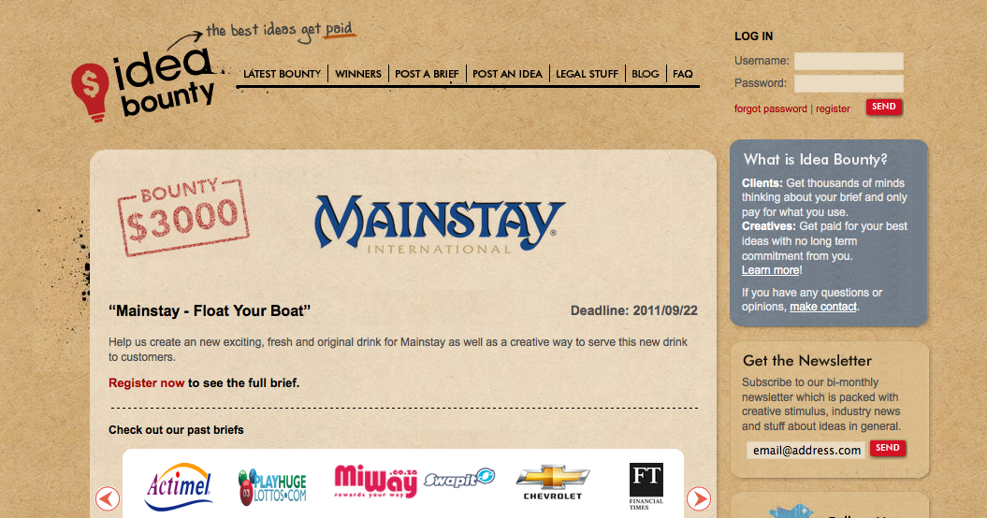
Idea Bounty
Any thoughts? Tweet them @evly

Slide 11
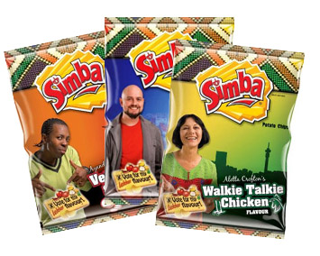

Remember the Simba “design your flavor” campaign?
Why did they run that campaign?
Customer Engagement or Crowdsourcing a new flavor?
Any thoughts? Tweet them @evly

Slide 12
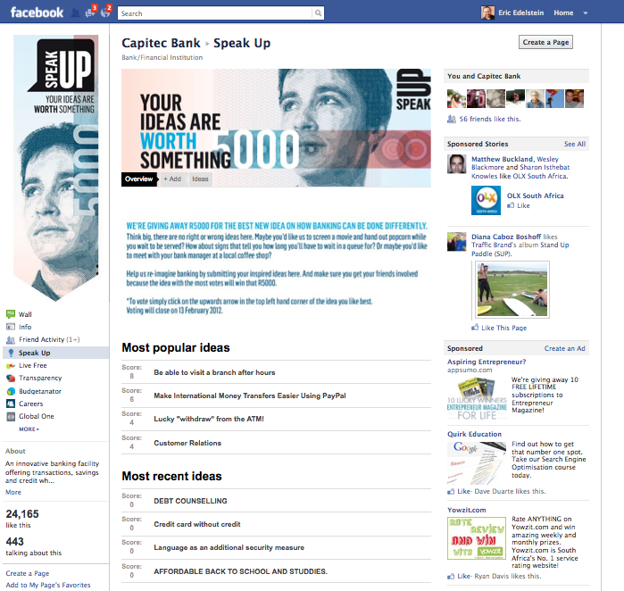
Capitec Bank
Used evly’s Ideas app to generate innovative ideas on how to improve consumer banking in South Africa

Slide 13
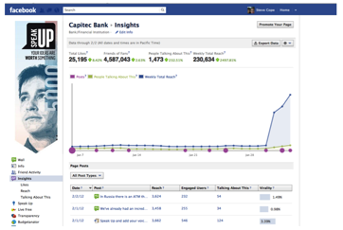
Capitec Bank
Challenge:
Harvest ideas to make local banking better
Create a forum where Capitec and non-Capitec customers can converge and engage
within a transparent, supportive and viral environment
Commissioned by King James’s PR - Atmosphere
Solution:
Used the evly Ideas app to generate innovative ideas from the public on how to improve consumer banking in SA
Results:
700 unique ideas in under 4 weeks
2500% increase in engagement on Fan Page in first week
Campaign Reach: 235 000
Entirely inclusive and accessible environment for participation
Case study submitted to Finance Minister, Pravin Gordhan
Any thoughts? Tweet them @evly

Slide 14
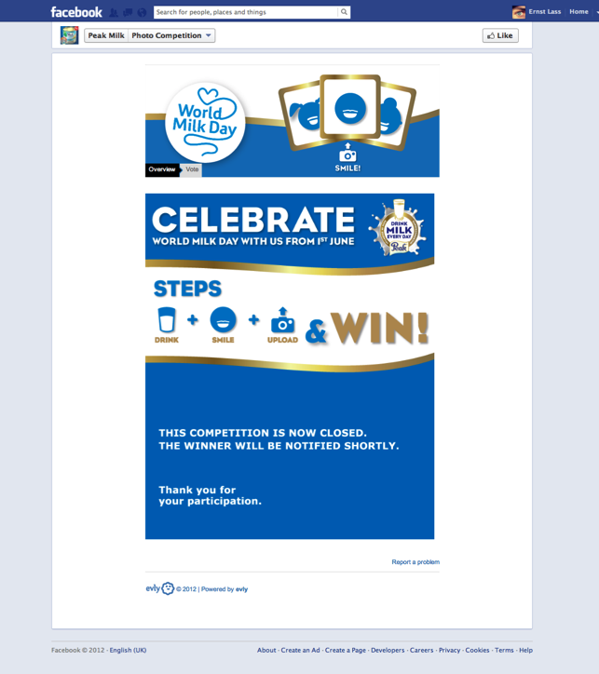

Peak Milk
Leading Nigerian FMCG milk brand
90% of campaign activity on mobile

Slide 15
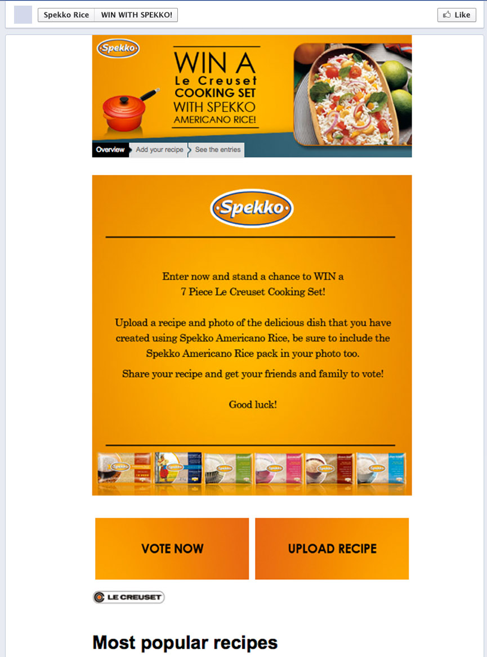
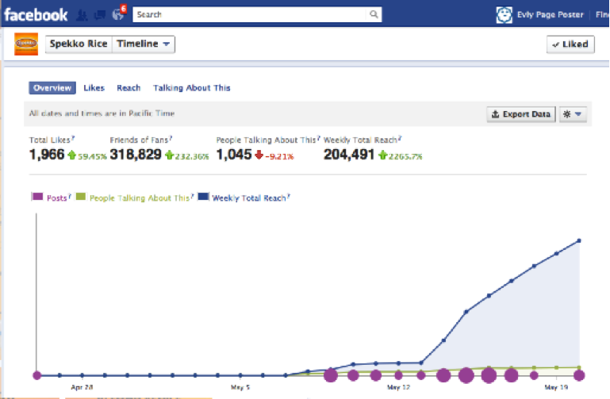
Spekko Rice
Challenge:
The Buchanan group wanted to create a community around the brand.
evly was the competition platform for Upload a recipe using Spekko Rice
Results:
In less than 2 weeks there are over 2000 fans, 50% of which have come through the evilly app
Any thoughts? Tweet them @evly

Slide 16
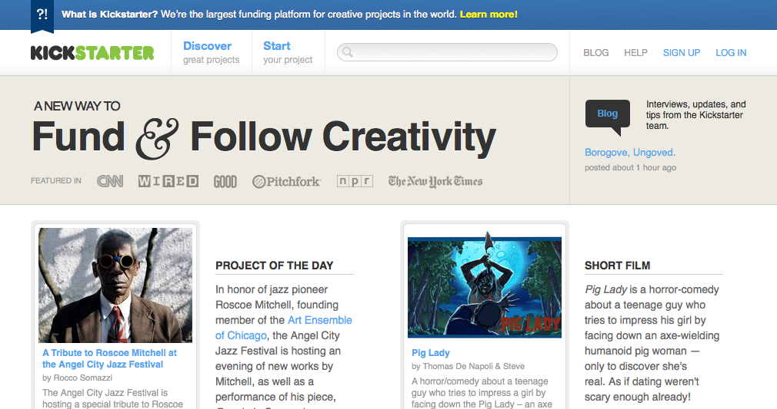
Kickstarter
Any thoughts? Tweet them @evly

Slide 17
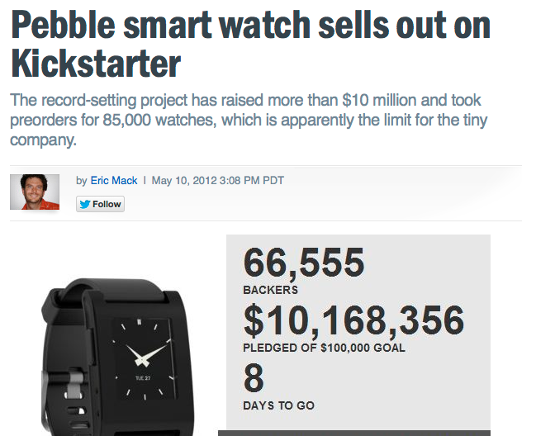
Pebble smart watches
Any thoughts? Tweet them @evly

Slide 18
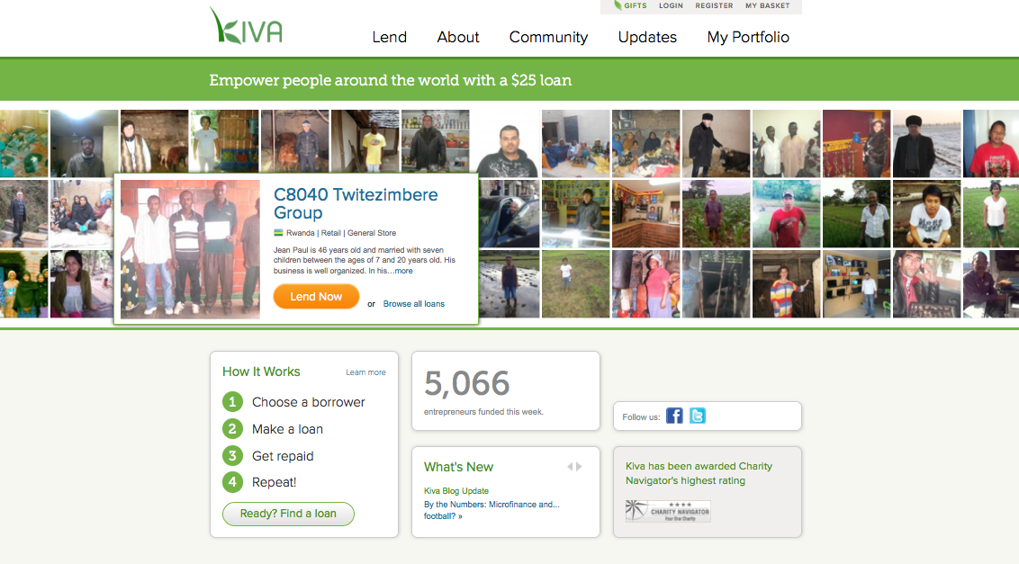
KIVA
Any thoughts? Tweet them @evly

Slide 19
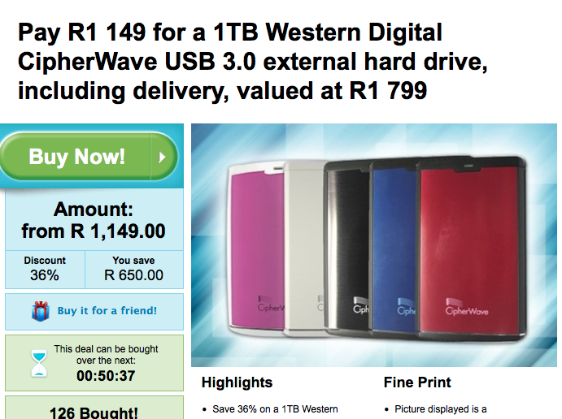
Group buying
Any thoughts? Tweet them @evly

Slide 20

Iterative
grapes
starting point
blend
ideas
name
creative
slogan
copy
label
design
Any thoughts? Tweet them @evly

Slide 21
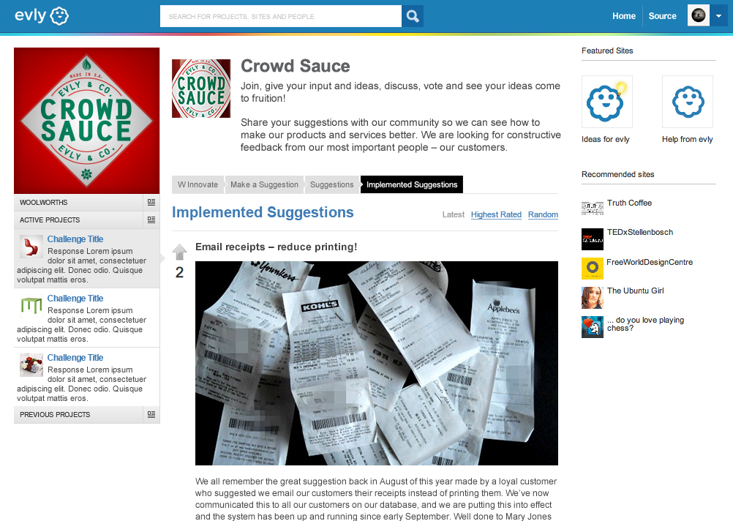
Campaign Repository
Any thoughts? Tweet them @evly

Slide 22

Take Away
Get people ENGAGED in your organisation (user generated content, sharing, voting, commenting, buying)
Let them add BUSINESS VALUE (market research, idea generation, creative input) to your organisation

Slide 23
Thank you
email:
Skype:
Tel:
twitter:
eric@evlycom
esoterict
+27 82 926 5447 (SA)
@EricEdelstein @evly

