Slide 1

Inspiring Possibility

Slide 2


R3bn annual revenue
1000 employees
R4bn in infrastructure
South Africa’s fibre leader
5 submarine cables
6 years of operation
1st carrier SIP voice
Africa’s 1st Tier 1 ISP
1st 10 Gbps IP core
Inspiring Possibility
1st public telepresence
1st wireless home phone
1st Next Generation Network
1st Metro Ethernet
1st fibre broadband

Slide 3

Global public
telepresence pioneer
Revenue $2.9bn
Largest voice carrier >50 billion min/year
300 Locations in 200 Countries on 6 Continents
42 global data centres – 100,000 square metres
350,000 route-km of submarine cable
Seventh largest Tier 1 ISP
8 Terabits/s of lit international capacity
1,600 Petabits per month

Slide 4

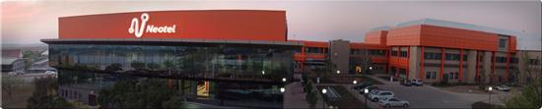
All IP network
First Tier 1 ISP in Africa
Next Generation Network
Global IP network
Content Delivery Network
Fibre Access leader
IP Leader
Global Ethernet
10 Gbps IP core
IPv6 leader
Inspired Possibility
IP Voice leader
Metro Ethernet leader
Notes:
Neotel is an IP leader.

Slide 5
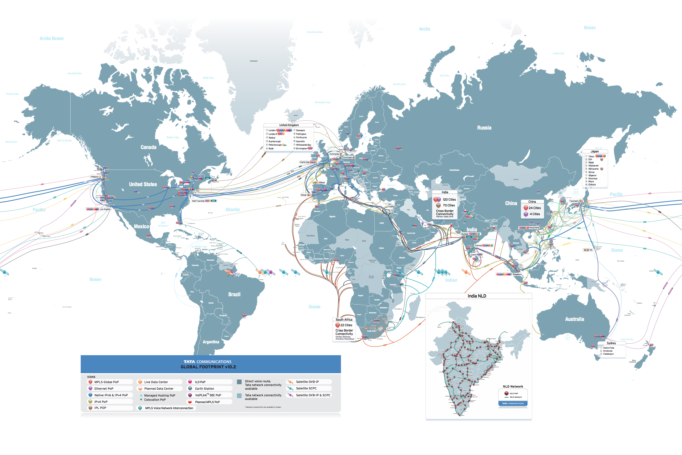
Global Submarine Cable Network
OWN
CONSORTIUM
NEW BUILDS
TGN-Atlantic
TGN Western Europe
TGN Northern Europe
TGN-Pacific
TGN-Intra Asia
SMW-3
SMW-4
SAFE/SAT-3
APCN-2
TGN-Eurasia
IMEWE
SEACOM
WACS
Cross-border builds

Slide 6
Africa’s Tier 1 Internet
Seventh ranked global IP network – greatest geographic reach
Own CDN and caching – global content, local speed
Lowest latency Internet –
  Round Trip Time Jo’burg to…
  Cape Town: 20 ms
  Europe: 180 ms
  North America (E): 230 ms
  North America (W): 300 ms
  South Asia: 100 ms
  Far East: 180 ms
  Australia: 330 ms
Fully peered in South Africa – shortest paths to local networks

Slide 7
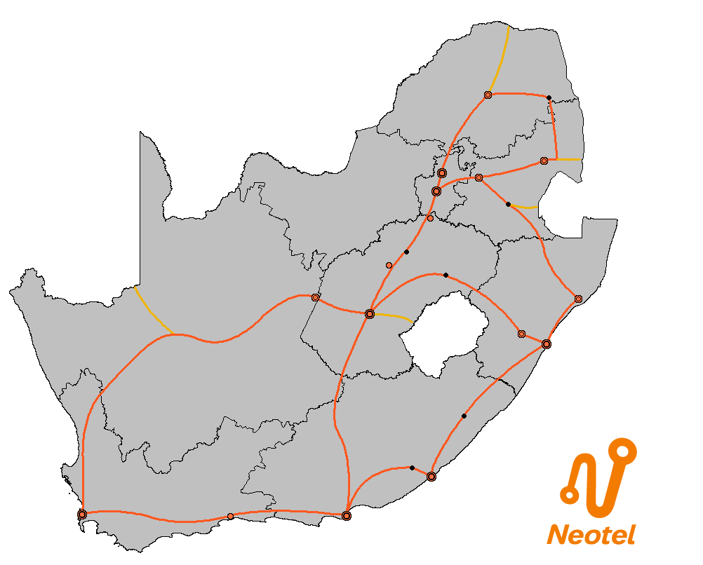
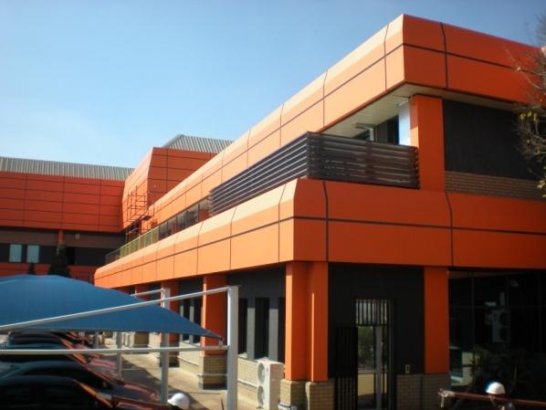
Connecting South Africa – 2006-2012
ZIMBABWE
DATA CENTRES
Tier 3: Midrand, CT
METROPOLITAN NETWORKS
6500 km in Gauteng, CT, Durban
POLOKWANE
Phalaborwa
NATIONAL LONG DISTANCE
12000 km, to all 40 main cities and towns
4000 km upgrade to new fibre in 2012
BOTSWANA
MOZAMBIQUE
NELSPRUIT
PRETORIA
WITBANK
EASSy
JOHANNESBURG
SWAZILAND
Ermelo
NAMIBIA
Sasolburg
SEACOM
Welkom
SAFE
KIMBERLEY
Bethlehem
Ladysmith
RICHARDS BAY
BLOEMFONTEIN
LESOTHO
PIETERMARITZBURG
Mtunzini
DURBAN
WACS
Umtata
SAT-3
Yzerfontein
Bisho
Melkbosstrand
EAST LONDON
CAPE TOWN
PORT ELIZABETH
George
SAFE
Notes:
10 Gbps wavelengths, using DWDM and ASON

Slide 8
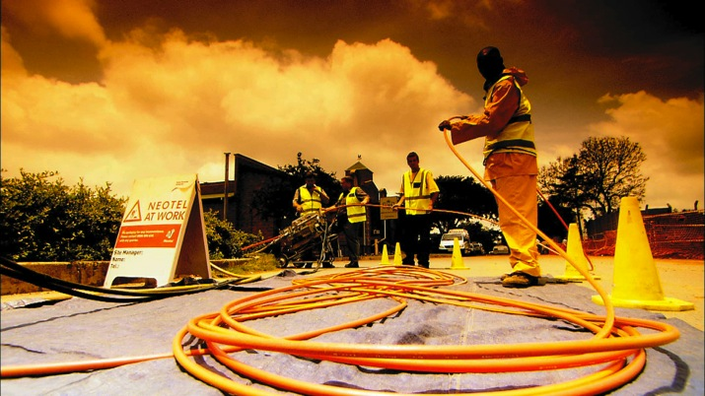
Highly scalable
Highest speed
1 Gbps as standard
NeoMetro
6,500 km of fibre
Carrier features
The new leased line
MEF compliant
Line or tree topology
SA’s first Metro Ethernet
Notes:
NeoMetro is the IP world’s replacement for conventional leased line transmission.

Slide 9














Global Tier 1 ISP
All five submarine cables
Lowest international latency
Consumption-based pricing
NeoInternet
Up to 1 Gbps on Ethernet
95th percentile
Simply the best Internet
High bandwidth
Fully peered in South Africa

Slide 10
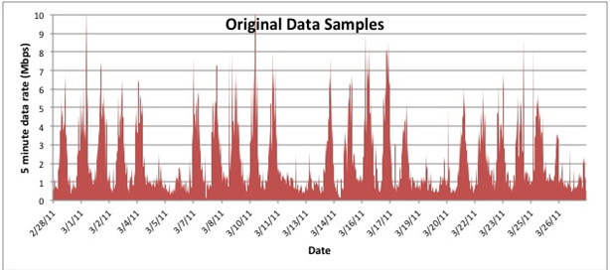
Default ISP Model
10 Mbps Last Mile (Fixed MRC )
10 Mbps Internet Access Port (Fixed MRC)

Slide 11
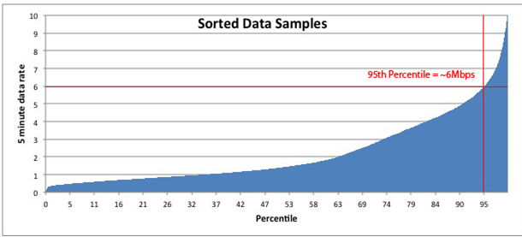
95th Percentile Model
Last mile – Fixed MRC
Internet Access Port – Variable MRC)
5 min samples over 30 day period – Ignore top 5% !!

Slide 12
NeoInternet 95th Percentile Billing
Key benefits:
“Pay as you go” methodology - no wasted bandwidth!
Flexibility
Don’t pay for the “peaks”
Scale pricing benefits
Quick upgrades

Slide 13

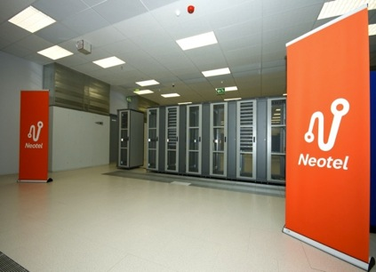
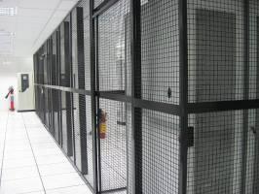
Integrated Connectivity
Pay per use bandwidth and power
Tier 3 Data Centres
Energy efficiency
Security
NeoHost
Virtual servers
Managed hosting
A home for data
Carrier neutral meet-me

Slide 14
3 Hosting Bundle Options
3 separate but related bundles
Leverage off the capabilities inherent in our network to provide network services bundled with our hosting services
Bandwidth between Johannesburg and Cape Town
FREE bundled replication bandwidth between Neotel’s 2 data centres in Johannesburg and Cape Town
JINX/CINX Connectivity
FREE 100mbps bandwidth for ISPA members from Neotel’s MMR to JINX or CINX
MPLS/Metro/Neo One access
FREE bandwidth on MPLS ports when connecting customer sites to the Neotel Data centres
1
2
3

Slide 15
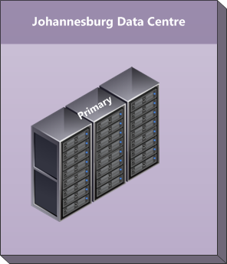
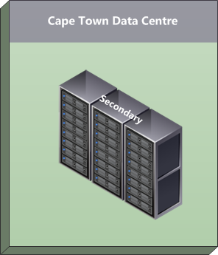


Neotel Solution
Leverage Neotel’s two data centres and national network to provide a data replication environment for our customers across the country
Data
Replication
Customer servers in Johannesburg and Cape Town data centre
MPLS
MPLS
Various customer branch locations around the country
Neotel IP Network used to connect branches with data centres
Bundled in (free!) replication bandwidth for customers between Johannesburg and Cape Town bundled in
MPLS
MPLS
MPLS
MPLS

Slide 16
Replication Bandwidth
Hosting service | Bandwidth included per side | Minimum bundled bandwidth
Secure Full rack | 5 mbps | 10 mbps (1 rack on each side)
Managed Storage 100 GB FC | 1 mbps | 2 mbps (100 GB on each side)
Virtual Host Gold | 1 mpbs | 2 mbps (server on each side)
Virtual Host Platinum | 2 mbps | 4 mbps (server on each side)
Johannesburg DC
Cape Town DC
2 racks
10 mbps

Slide 17
Free MPLS VPN Access
For each class of service, the MPLS port in the data is the sum total of the bandwidth at all the remote sites
Port | COS1 bandwidth | COS2 bandwidth | COS3 bandwidth | COS4 bandwidth
Site 1 – Port P1 | 1 mbps |  | 2 mbps | 4 mbps
Site 2 – Port P2 |  | 2 mbps |  | 1 mbps
Site 3 – Port P3 |  | 2 mbps | 1 mbps | 2 mbps
Site 4 – Port P4 FREE!!! | 1 mbps | 4 mbps | 3 mbps | 7 mbps

Slide 18
Free JINX / CINX Connectivity
100 Mbps
This solution incentivises Meet Me Room customers to peer locally inside the Neotel data centre, while alleviating the burden to them of having to install network services at the IS data centres

Slide 19
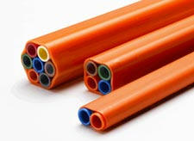
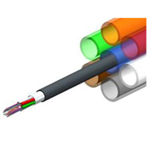
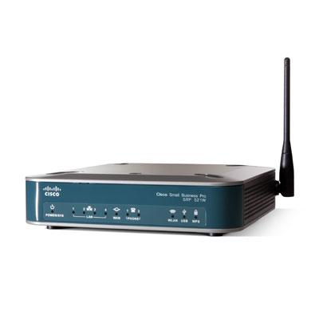
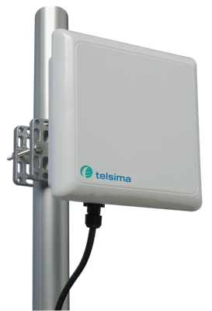
On-demand boost button
True broadband
Up to 15 Mbps symmetrical
Uncapped, unshaped, low contention
Fibre or WiMAX
NeoBroadband
Voice
SA’s broadband flagship
Best Internet performance
World class network
Notes:
True Broadband
SA’s broadband flagship

Slide 20
Thank you

