Slide 1

10 September 2012
Crystal Towers, Century City.
Cape Town

Slide 2
Five Years of Protecting Intellectual Property Rights in ZA:
Lessons Learned to date
Charles Webster
Spoor & Fisher

Slide 3
Outline:
A-Z of the ADR process
Trends
Lessons learned

Slide 4


A is for
Alternative Dispute Resolution

Slide 5
Alternative Dispute Resolution
Not your usual judicial process
But similar to other Intellectual Property issues
  Trade mark oppositions
  Close corporation name objections (under 1973 Act)
High Court infringement proceedings

Slide 6

B is for
Balance of Probabilities

Slide 7
Balance of Probabilities
Reg 3 (2): The Complainant is required to prove on a balance of probabilities to the adjudicator that the required elements in subreg (1) are present.

Slide 8

C is for
Complainant

Slide 9

D is for

Slide 10
Domain Name Disputes
The registration of a domain name may lead to a dispute and three possible decisions may arise:
Refusal of the dispute or the transfer of the name to the complainant (for abusive registrations)
Refusal of the dispute or the deletion and prohibition of the domain name (for offensive registrations)
Refusal of the dispute as the dispute constitutes reverse domain name hi-jacking.

Slide 11
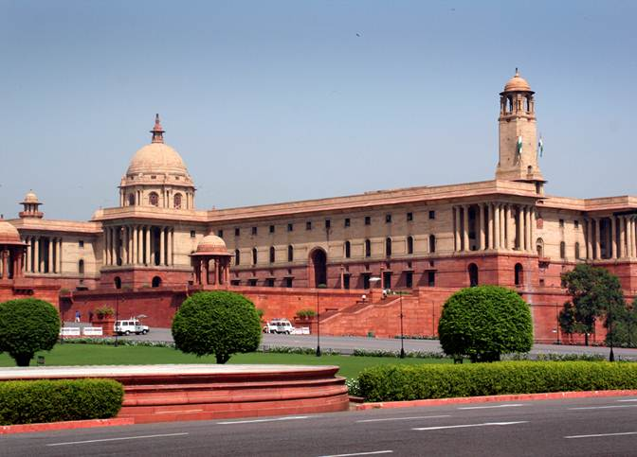
E is for
Electronic Communications and Transactions Act 25 of 2002

Slide 12
Electronic Communications and Transactions Act 25 of 2002
The Alternative Dispute Resolution Regulations published in Government Gazette no. 29405 of 22 November 2006 under Section 69 read with Section 94 of the Act

Slide 13

F is for
Factors

Slide 14
Factors
Which may indicate that a domain name is an abusive registration (Reg 4(1))
Which may indicate that a domain name is not an abusive registration (Reg 5).
List not exhaustive

Slide 15
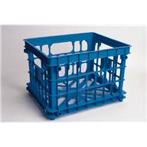
G is for
Generic

Slide 16
Generic
Where the domain name is
used generically; or
in a descriptive manner; and
the registrant is making fair use of it,
these are factors which may indicate that the domain name is not an abusive registration (Reg 5(b)).
mr.plastic.co.za ZA 2007-0001
va.co.za ZA 2011-0098

Slide 17


H is for
Hatred

Slide 18
Hatred
An offensive registration may be indicated if the domain name advocates hatred that is based on race, ethnicity, gender or religion and/or that constitutes incitement to cause harm (Reg 4(2)).

Slide 19
I is for
IP rights

Slide 20
IP rights
“Rights” and “registered rights” include
intellectual property rights,
commercial,
cultural,
linguistic,
religious and personal rights
protected under South African law, but is not limited thereto.

Slide 21

J is for
Judgment of the High Court

Slide 22
Judgment of the High Court
Reg 11(4) provides that if the second level domain administrator learns that legal action has commenced, it may not implement the adjudicator’s decision, and the second level domain administrator must not take further action until it receives –
Proof of a resolution or settlement between the parties;
Proof that the lawsuit has been dismissed or withdrawn; or
A copy of a Court order

Slide 23

K is for
R10K and R24K

Slide 24
R10K and R24K
A complainant must pay
R10 000 for one adjudicator (Reg 34(1))
R24 000 for three adjudicators (Reg 34 (1))
R24 000 appeal fee (Reg 34 (3))

Slide 25

L is for
Legitimate

Slide 26
Legitimate
Where the registrant has been
commonly known by the name; or
legitimately connected with a mark
which is identical or similar to the domain name (Reg 5(a)(ii)); or
made legitimate non-commercial or fair use of the domain name (Reg 5(a)(iii))
these are factors which may indicate that the domain name is not an abusive registration.

Slide 27

M is for
Mores

Slide 28
Mores
Offensive registration
contrary to law
contra bonos mores
likely to give offence to any class of persons

Slide 29
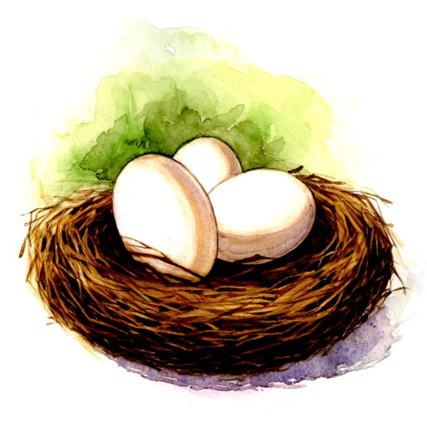

N is for
National Decisions

Slide 30
National Decisions
Reg 13(1) dealing with precedent provides that an adjudicator must be guided by
previous decisions made in terms of the Regulations (national decisions), and
decisions by foreign dispute resolution providers.

Slide 31

O is for
Offensive

Slide 32
Offensive
Reg 4(2) provides that an offensive registration may be indicated if the domain name advocates hatred that is based on race, ethnicity, gender or religion and/or that constitutes incitement to cause harm.

Slide 33

P is for
Procedure

Slide 34
Procedure
Procedure means the procedural rules in terms of which a dispute is to be conducted as set out in chapter III.

Slide 35

Q is for
Queue

Slide 36
Queue
There are 48 active adjudicators queuing up for an opportunity to adjudicate in a dispute.
The most prolific adjudicators are:
Owen Salmon (21)
André van der Merwe (12)
Gavin Morley (10)

Slide 37

R is for
Registrant

Slide 38

S is for
Second Level Domain Administrator

Slide 39
Second Level Domain Administrator
The entity licenced, or to be licensed by the Authority to operate as a second level domain in the .za domain name space.

Slide 40


T is for
Transfer of the Domain Name

Slide 41
Transfer of the Domain Name
Reg 9(a): Disputed name is transferred in successful abusive registration complaint
Reg 12: May not transfer name while dispute pending

Slide 42


U is for
Unfair advantage

Slide 43
Unfair advantage
Criteria for abusive registration include:
Took/takes unfair advantage
Was/is unfairly detrimental

Slide 44

V is for
Valuable Consideration

Slide 45
Valuable Consideration
Abusive registration if name acquired primarily to sell for price in excess of out of pocket expenses.

Slide 46
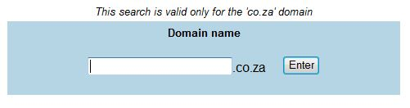

W is for
Whois Database

Slide 47

X is for
Xnets.co.za ZA2011-0077
XnetS

Slide 48

Y is for
Why do we have ADR regulations?

Slide 49

Z is for
To protect .za domain names

Slide 50
.co.za
Reg 2(2): Only Internet domain names registered in the .co.za second level domain are covered by regulations.

Slide 51
Trends

Slide 52
Trends
Total Cases Filed | 115
Cases Settled | 27 | 23.5%
Cases Pending | 2 | 1.7%
Cases Decided | 86 | 74.89%
Cases Appealed | 6 | 5%

Slide 53
Trends
Legal Counsel
Complainant represented | 108 | 81.2%
Registrant represented | 25 | 18.8%

Slide 54
Trends
Cases Opposed | 39 | 46.4% of cases decided
Cases Unopposed | 45 | 53.6% of cases decided
Successful Disputes | 68 | 82.9% of cases decided
Unsuccessful Disputes | 45 | 17.1% of cases decided

Slide 55
Trends
Successful Disputes
Opposed cases (transfer) | 25 | 67.6% of opposed cases
Unopposed cases (transfer) | 45 | 100% of unopposed cases
Unsuccessful Disputes
Opposed cases (refused) | 12 | 32.4% of opposed cases
Unopposed cases (refused) | 0 | 0% of unopposed cases

Slide 56
Abusive registration - 3 requirements
Lessons Learned:
Complainant must prove each of the following:
that it has rights in respect of a name or mark,
which is identical or similar to the domain name, and
in the hands of the registrant the domain name is an abusive registration
All disputes thus far based on alleged abuse
Regulation 3(1)
(Reg 3(2): offensive registration)

Slide 57
Relevant date: rights
right at date of complaint
not registration date of domain name
but timing relevant to legitimate interest and bad faith
mixit.co.za ZA2008-0020

Slide 58
Rights
Threshold is fairly low
Main point is complainant must have proper interest
“rights” not trammeled by trade mark jurisprudence
  nutri-ag.co.za ZA2011-0102
  xnets.co.za ZA2011-0077
  seido.co.za ZA2009-0030
Rights can be obtained in a two letter mark (but addition of one or more characters may then distinguish)
  va.co.za ZA2011-0098

Slide 59
Examples of recent cases where no rights established:
thelittleblackbook.co.za ZA2011-0103
- complainant mere licensee
nyama-spitbraai.co.za ZA2011-0092
- nyama means meat: Zulu
- lack of evidence of reputation / secondary meaning
outsource.co.za ZA2011-0070
- outsource is descriptive
- trade marks and company names incorporating “outsource” not enough
- lack of evidence of reputation

Slide 60
Other examples of cases where no rights established:
privatesale.co.za ZA2007-0008
- complainant’s private-sale.co.za comprise two hyphenated words both of which describe aspects of relevant business
- lack of evidence of reputation
weskusmall.co.za ZA2009-0029
- no evidence of use
- “West Coast” (Weskus) is a geographical indicator

Slide 61
But see:
mares.co.za ZA2008-0016
Complainant a distributor
- cannot claim proprietary rights to marks
- can claim commercial rights pursuant to the distribution agreement
abusive factors compared against complainant’s rights (as distributor) and dispute refused.
va.co.za ZA2011-0098
- sufficient rights in V&A for locus standi
- rights limited in scope (with consequences)

Slide 62
Abusive registration - definition
A domain name which either:
was registered or otherwise acquired in a manner
at the time when registration took place
took unfair advantage of, or was unfairly detrimental to the complainant’s rights, or
has been used in a manner
that takes unfair advantage of, or is unfairly detrimental to the complainant’s rights
Regulation (1)(b)

Slide 63
Relevant date: abuse
Registration can be abusive “now” although not “then”
Can become abusive depending on use
Potential for “bait and switch” is sufficient to constitute abuse whether in fact effected or not
xnets.co.za ZA2011-0077

Slide 64
Abusive registration - factors
Registered primarily to:
sell, rent or otherwise transfer
to a complainant or, complainant’s competitor or third party
for valuable consideration in excess of reasonable expenses
Regulation 4(1)(a)(i)

Slide 65

Valuable consideration in excess:
sterkinikor.co.za ZA2012-0107
- R204 000
dedrego.co.za ZA2012-0110
- R250 000

Slide 66
Valuable consideration in excess:
Even if no consideration quantified:
“We are the domain holder of the domain movingforward.co.za. We have been approached by a commercial party to sell this domain. Please let me know if Standard Bank is interested as we will otherwise proceed with the sale of this domain”
movingforward.co.za ZA2010-0050
Decision i.t.o. 4(1)(c) though (pattern of abusive registrations)

Slide 67
Abusive registration - factors
Registered primarily to:
block intentionally the registration of a name or a mark in which the complainant has rights
  Regulation 4(1)(a)(ii)
disrupt unfairly the business of the complainant
  Regulation 4(1)(a)(iii)
prevent the complainant from exercising his, her or its rights
  Regulation 4(1)(a)(iv)

Slide 68
Abusive registration - factors
Circumstances indicating that the registrant is using, or has registered, the domain name in a way that leads people or businesses to believe that the domain name is registered to, operated or authorised by, or otherwise connected with the complainant.
Regulation 4(1)(b)

Slide 69

Adverse inference
The registration of an identical domain name may raise presumption that registration is abusive
Because impossible to infer that it was chosen for any reason other than to impersonate the complainant
fifa.co.za ZA2007-0007

Slide 70
Adverse inference
Where Registrant has adopted a domain name
to all intents and purposes identical to Complainant’s rights
without any explanation for conduct
reasonable to infer that Registrant operating in same field
registered domain name primarily to :
  disrupt unfairly the business, or
  block intentionally, or
  leads people to believe a connection
  nutri-ag.co.za ZA2011-0102

Slide 71
Abusive registration - factors
Evidence, in combination with other circumstances, indicating that the domain name in dispute is an abusive registration, that the registrant is engaged in a pattern of making abusive registrations.
Regulation 4(1)(c)

Slide 72

A Pattern
A further factor may be evidence of a pattern:
elitemodel.co.za ZA2009-0032
ketelone.co.za ZA2009-0037
hackett.co.za ZA2009-0033
absapremiership.co.za ZA2009-0034
The “three strikes” rule may – or may not – operate in future

Slide 73
Abusive registration - factors
There shall be a rebuttable presumption of abusive registration if the complainant proves that the registrant has been found to have made an abusive registration in three or more disputes in the 12 months before the dispute was filed.
Regulation 4(3)

Slide 74

Digital Orange / Joris Kroner
19 February 2010: peroni.co.za ZA2009-0038
Three strikes rule applied:
hackett.co.za 10 September 2009
absapremiership.co.za 20 September 2009
ketelone.co.za 15 December 2009
and again in googleadsense ZA2010-0055

Slide 75
Abusive registration - factors
False or incomplete contact details provided by the registrant in the whois database
Regulation 4 (1)(d)
sterkinikor.co.za ZA2012-0107

Slide 76
Abusive registration - factors
The circumstance that the domain name was registered as a result of a relationship between the complainant and the registrant, and the complainant has
been using the domain name registration exclusively; and
paid for the registration or renewal of the domain name registration.
Regulation 4(1)(e)

Slide 77
Not an Abusive registration - factors
Before being aware of the complainant’s cause for complaint, the registrant has
used or made demonstrable preparations to use the domain name in connection with a good faith offering of goods or services;
been commonly known by the name or legitimately connected with a mark which is identical or similar to the domain name; or
made legitimate non-commercial or fair use of the domain name.
Regulation 5(a)

Slide 78
Not an Abusive registration - factors
The domain name is used generically or in a descriptive manner and the registrant is making fair use of it.
Regulation 5(b)

Slide 79

Not an Abusive registration - factors
That the registrant has demonstrated fair use, which use may include websites operated solely in tribute to or fair criticism of a person or business: provided that the burden of proof shifts to the registrant to show that the domain name is not an abusive registration if the domain name (not including the first and second suffixes) is identical to the mark in which the complainant asserts rights, without any addition.
Regulation 5(c)

Slide 80
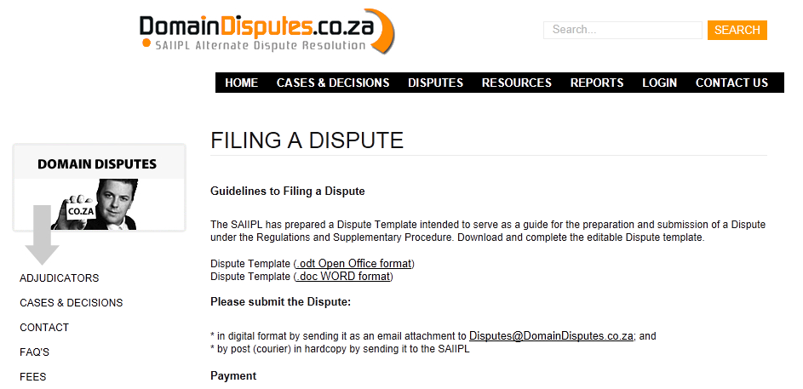

Slide 81
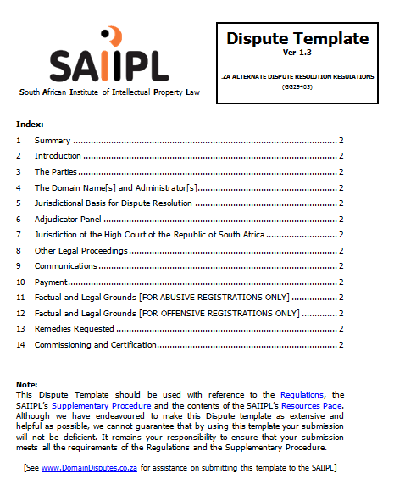

Slide 82
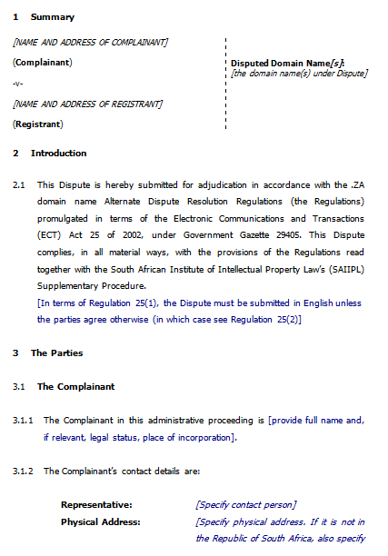

Slide 83

Lessons Learned:
mr.plastic.co.za ZA2007-0001
va.co.za ZA2011-0098

Slide 84


Lessons Learned:
chore-timebrock.co.za ZA2012-0112
sterkinikor.co.za ZA2012-0107
picknpayhypermarket.co.za ZA2011-0101 (settled)
bakubunglodge.co.za ZA2011-0093

Slide 85


QUESTIONS?
Charles Webster
(012) 676 1279
c.webster@spoor.com

