Slide 1


Presentation
to iWeek 2010
16 September 2010

Slide 2

Scope of Presentation
Background
Market Focus
Value Proposition
Products and Services
National Network Infrastructure
WACS International Cable System
Commercial Launch Projects
The Year Ahead...
The Future of Internet in South Africa...
Slide 2

Slide 3
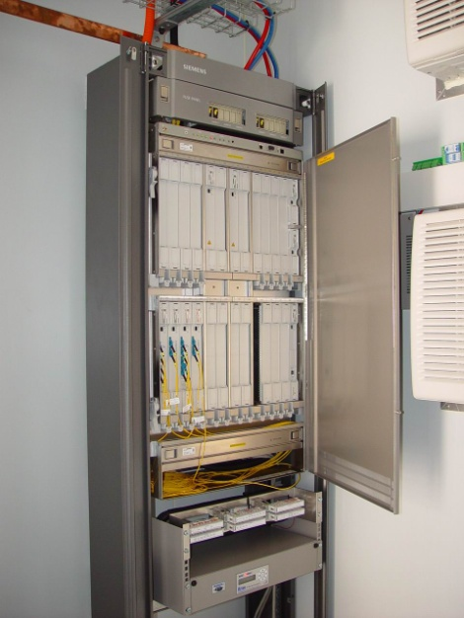


Background
Broadband Infraco was initiated in 2006
We acquired fibre-optic network assets from Eskom & Transnet (~ 5,000km of optical transmission links)
A Four year Contract was negotiated with Neotel which commenced in 2008 and included:
  Sole use of the network infrastructure (prior to licensing)
  Outsourcing of Operations & Maintenance of the infrastructure
Broadband Infraco was awarded an i-ECNS license on 19 October 2009
  Now empowered to implement wholesale business model
Slide 3

Slide 4

Market Focus
Broadband Infraco sells wholesale national long distance and international transmission services.
Our market focus is on licensed fixed and mobile network operators and ISPs in accordance with our I-ECNS License.
We will also focus on providing long distance connectivity to projects that are of national interest and to Underserviced Area licensees.
Slide 4

Slide 5

Value Proposition
The services offered by Broadband Infraco will allow its customers to improve their cost structure as it will allow them to:
  provide national connectivity at much lower cost and negate the need to invest capital in building their own long distance networks
  provide higher levels of service to their customers due to the addition of an alternative long distance service provider
  focus on their core business, such as metro fibre optic networks for metro backhaul, as well as fixed and wireless last mile services
  make best of use of the geographic diversity of the Broadband Infraco network
  benefit from the economies of scale that can be achieved through the aggregation of large volumes of long distance traffic from multiple operators.
Slide 5

Slide 6

Products and Services
Services are based upon the provision of high capacity managed bandwidth from Point of Presence (POP) to POP within our network.
Services are Synchronous Digital Hierarchy (SDH) based and available in the following bandwidths:
  STM-1, STM-4, STM-16, STM-64
  We are also able to provide Ethernet services in multiples of 100Mbit/s, 1Gbit/s & 10Gbit/s.
Service Levels – 99.5% (Standard), 99.95% (Platinum)
Contract options include 10 Year IRUs and 1, 3, 5 and 10 Year Leases.
Slide 6

Slide 7
National Network Infrastructure
The Broadband Infraco fibre optic network currently comprises of approximately 12 125 km of optical transmission routes.
The backbone network utilises the latest generation Dense Wavelength Division Multiplexing (DWDM) equipment, providing a number of 2.5 Gbit/s and 10 Gbit/s capacity connections along the majority of fibre routes.
Network extensions have also been implemented to provide fibre connectivity to the neighbouring countries of Botswana, Lesotho, Mozambique, Namibia, Swaziland, and Zimbabwe.
Broadband Infraco is also well positioned to link west coast and east coast international cable systems.

Slide 8
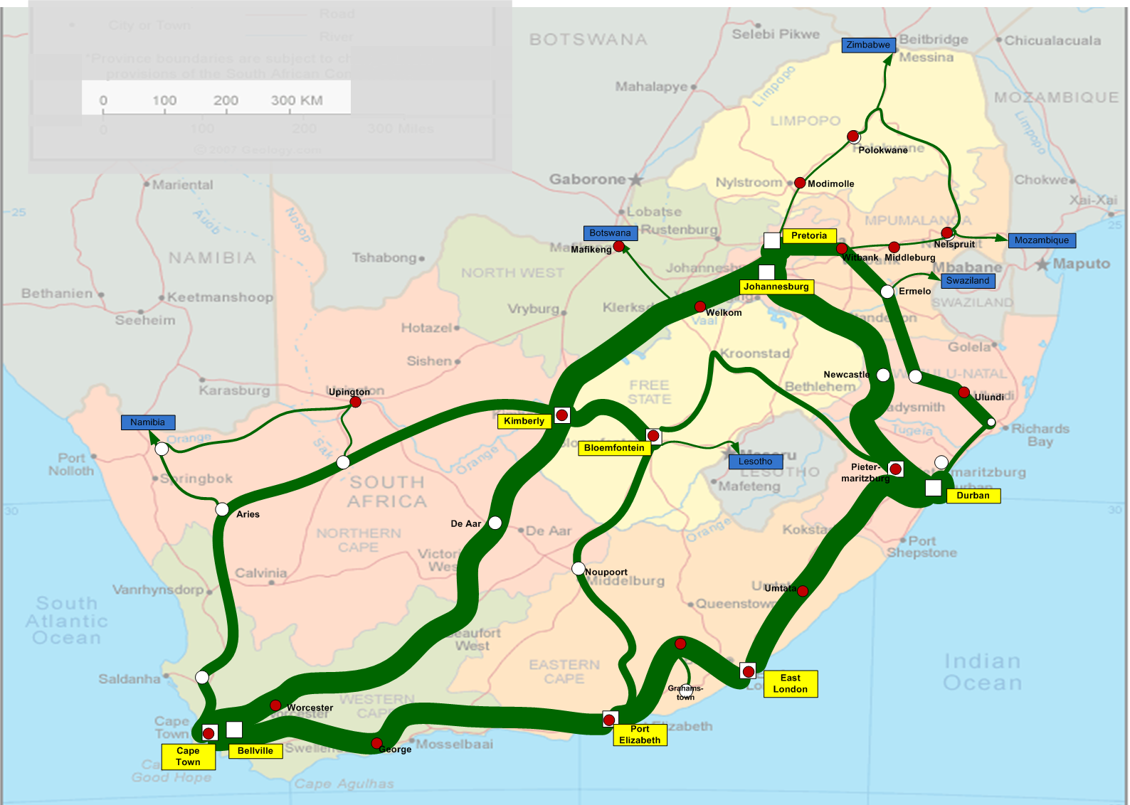
Current Network Infrastructure: 2008 / 2010
Additional fibre routes to close the rings to provide service protection capability
Overall capacity expansion
Inclusion of Limpopo SDH Ring (Northern Ring)
1
1
9
9
5
2
4
6
3
8
4
8
9
No. of 10 Gbit/s
8

Slide 9
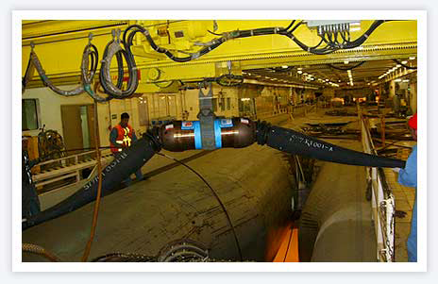

WACS International Cable System
C&MA and Supply Contract signed on 8 April 2009
WACS governance structures in place
Supply Contract came into force on 25 May 2009
Manufacturing of various cable system components is underway
Portugal shore-end cable has been installed
Main fibre route installation (cable ship load 1) to commence shortly
The landing station in South Africa will be at Yzerfontein and the system is expected to go live during the third quarter 2011.

Slide 10
Commercial Launch Activities
Slide 10

Slide 11

Launch Projects 1
Customer facing processes and systems are in place
    Open access connectivity points to the network have been established:
      Gauteng x 3 - Teraco Isando, Neotel Midrand, BCX Midrand
      Cape Town - Teraco Rondebosch
      Durban - IS Umhlanga Rocks
    Implementation of ASON complete and photonic cross connect protection planned
Additional 10Gbit/s lambdas lit across the network
‘Soft Launch’ (network trials) planned for August & September ‘10
Full launch expected Q4 2010
Slide 11

Slide 12

Launch Projects 2
O&M Enhancements
  Management of O&M being insourced from current provider
  NOC already relocated to Broadband Infraco offices in Woodmead
  Outsourced maintenance contracts to be transferred to Broadband Infraco shortly
  Broadband Infraco management and ‘working’ regional supervisory teams in place
  Significant improvements in MTTRs expected
Slide 12

Slide 13
Focus for the Year Ahead
Slide 13

Slide 14
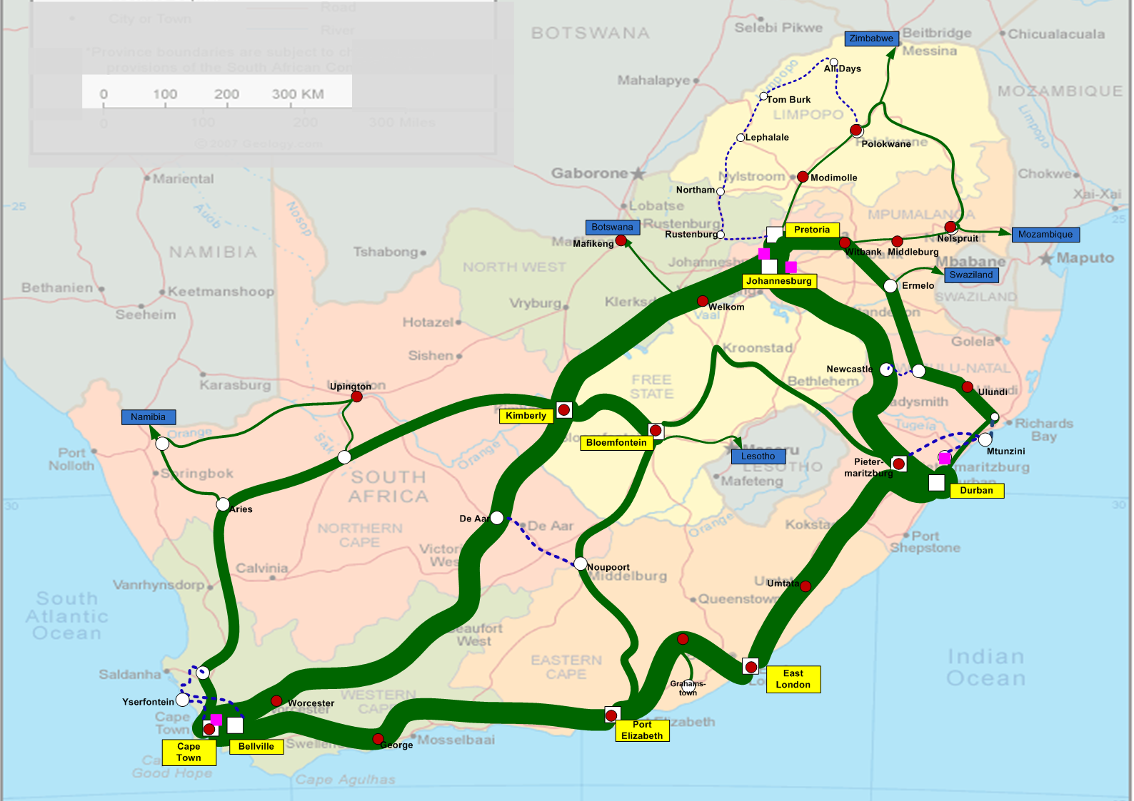
Current Network Infrastructure & Roadmap
Network Meshing for improved service quality
Links to the East and West coast submarine cable landing stations
3rd route to Polokwane
IP Core rollout
1
1
9
9
5
2
4
6
3
8
4
8
9
No. of 10Gig
8

Slide 15

Infrastructure Projects for the Year
Continued expansion of the network – 1,036 new fibre kilometres planned e.g. diversity to National borders
Roll out of additional ‘Open Access’ POPS e.g. Pretoria, PE, Bloemfontein, etc.
New 10Gbit/s lambdas across the network
IP MPLS Core (Johannesburg / Cape Town / Durban) – Layer 2 Services
Replacement of 20 channel DWDM with new generation 40 channel system
All of the above facilitating SLA improvements
Slide 15

Slide 16
The Future of Internet in South Africa....?
Slide 16

Slide 17
The Future of Internet in SA....?
Cost of International and National bandwidth will continue to reduce due to greater capacity and diversity.
Likely that internet access prices will drop by 20% to 30% in the next 3 years and then level out.
Bandwidth and usage will be used as key differentiators to achieve price points.
QoS will increasingly become a differentiator.
“Capped” Internet will continue for the foreseeable future however usage caps will increase.
“Uncapped” Internet will increase in availability (Fair Use policy)
Greater level of bundling across different sectors e.g. Banks.
Slide 17

Slide 18
Thank you
Slide 18

